Slide 1
Setter Injection with Map having Dependent Object
We can inject collection values by setter method in spring framework.
We can use three elements inside the property element. It can be:
list
set
map

Slide 2
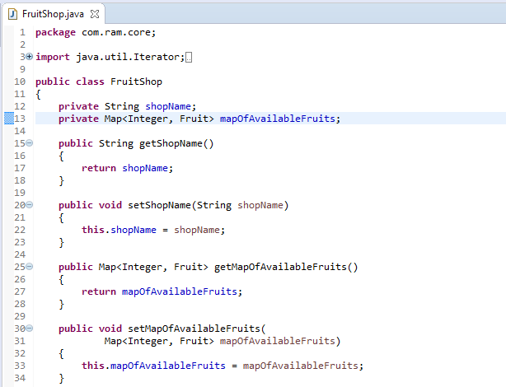
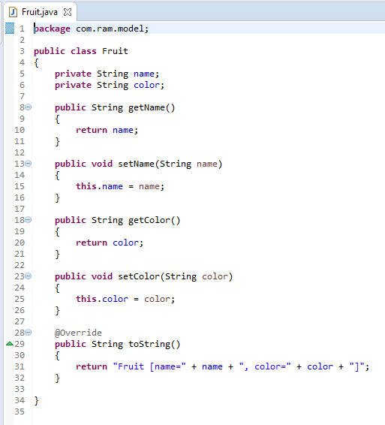
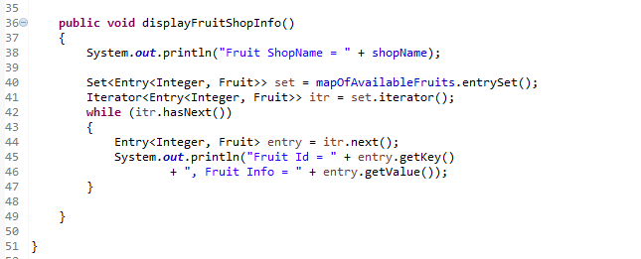
Setter Injection with Map having Dependent Object

Slide 3
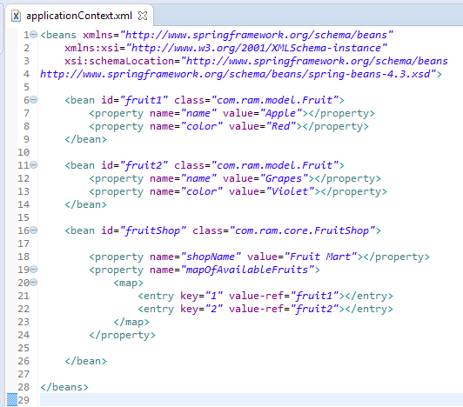
Setter Injection with Map having Dependent Object
We are providing the information into the bean by applicationContext.xml file.
The property element invokes the setter method.
The entry attribute of map is used to define the key and value information.
value-ref attributes of entry element is used to define the reference of bean in the map.
The map element of property is used here to define the map.

Slide 4
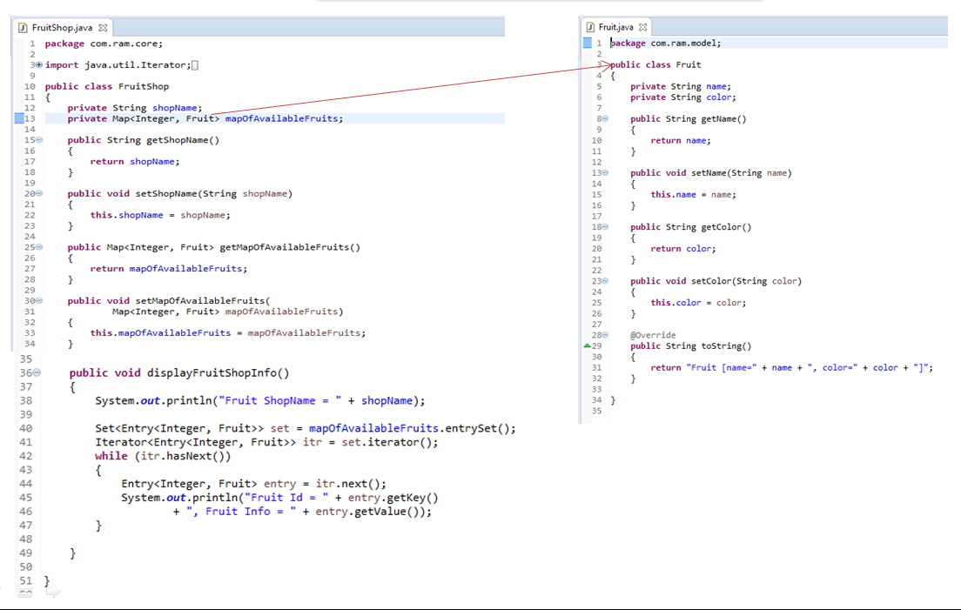
Setter Injection with Map having Dependent Object
FruitShop
What object to instantiate?
What object to configure and how to configure?
The Spring Container
(ApplicationContext)
applicationContext.xml
FruitShop
Object
shopName=Fruit Mart,
mapOfAvailableFruits=
{1=Fruit [name=Apple, color=Red],
2=Fruit [name=Grapes, color=Violet]}
Create the FruitShop object.
Configure the FruitShop object.
Manage FruitShop object complete life cycle from creation till destruction.

Slide 5
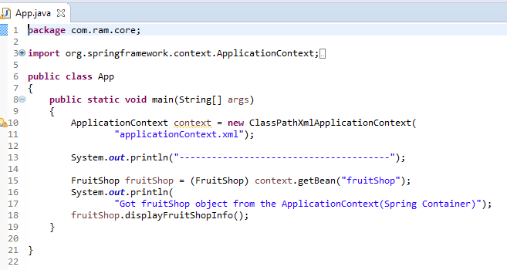
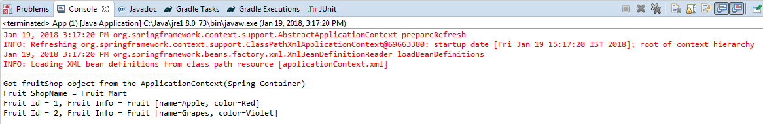
Setter Injection with Map having Dependent Object

